Slide 1
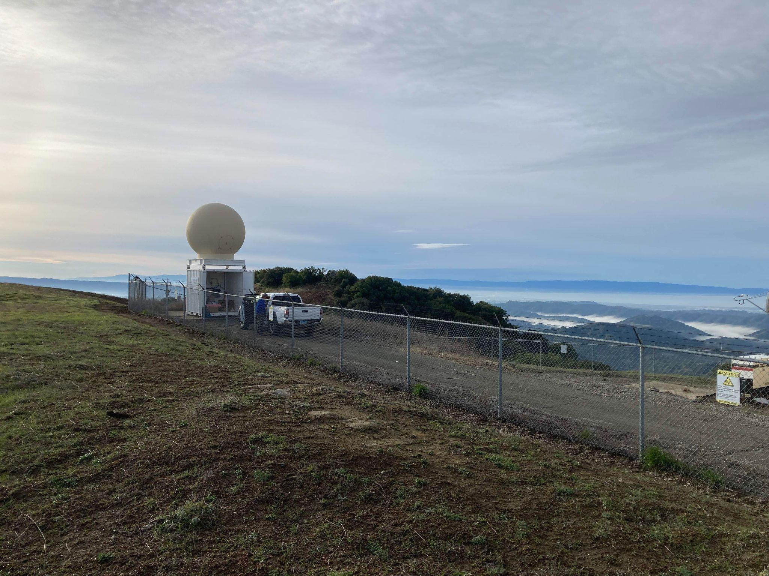
The AQPI Project (Advanced Quantitative Precipitation Information)
Building a State-of-the-Art Observation and Forecast System for the San Francisco Bay Area
Jon Rutz (CW3E)
November 2023
Acknowledgements:
M. Ralph (CW3E), J. Kalansky (CW3E) V. Chandrasekar (CSU), J. Lesher-Garcia (CSU),
D. Roberts (SCWA), J. Jasperse (formerly SCWA) R. Cifelli (NOAA), AQPI LPAC, Bay Planning Coalition

Slide 2
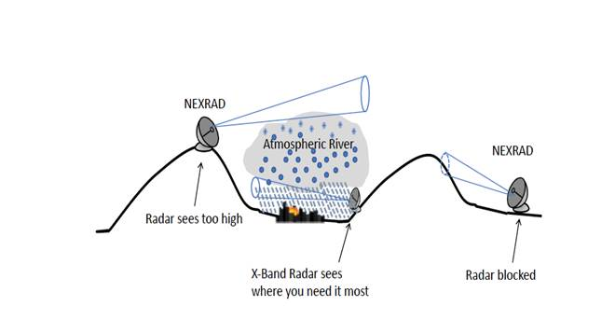
Why is AQPI Needed?
Who Needs AQPI?
Water Agencies
Municipal Utility Districts
Wastewater Management
Emergency Response
Flood Management
Public Works Departments
AQPI is needed for a number of reasons:
Existing Radar Weaknesses:
Existing radar can be blocked by terrain, overshoot areas of precipitation, or see precipitation that is not reaching the surface
Existing spatial and temporal frequency are not sufficient for stakeholder operations in a high-density, high-value urban environment
Weather Forecasting: operational staffing, logistics planning, wastewater and water resource management
Coastal Concerns: flooding and inundation
Climate change is making precipitation extremes more frequent and more extreme in northern CA
Who Needs AQPI?
Precipitation

Slide 3
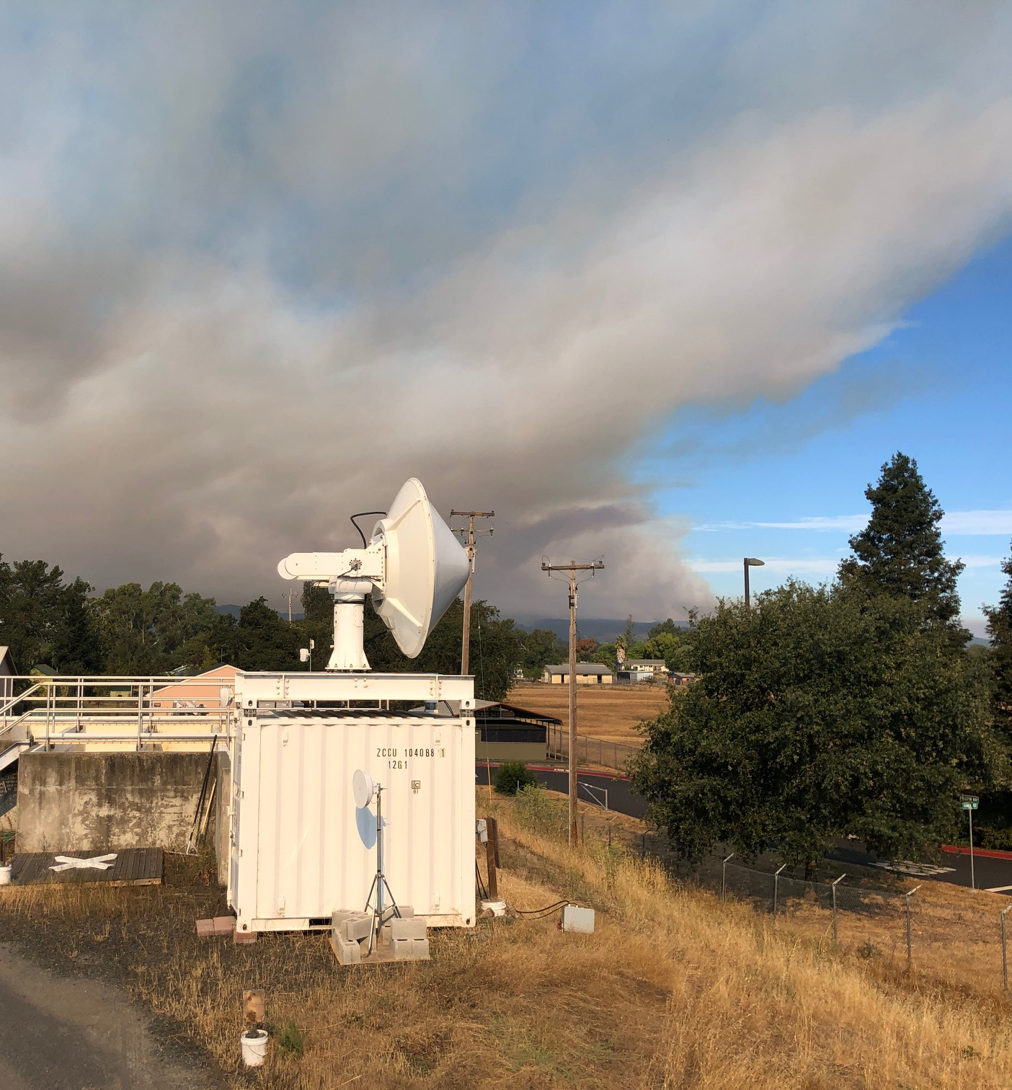
What is the AQPI System?
AQPI has several components
Observations: Additional radars to overcome beam blockage and overshoot, and meet user needs for for spatial and temporal frequency; additional rain/stream gauges for “ground truth”
Radar-Derived Products: quantitative precipitation estimate (QPE), Nowcast,
QPE can be used in H&H models
Weather Forecasts: short- and medium-range forecasts of precipitation and other relevant elements
Coastal Modeling: tides, waves, storm surge, coastal flooding and inundation

Slide 4
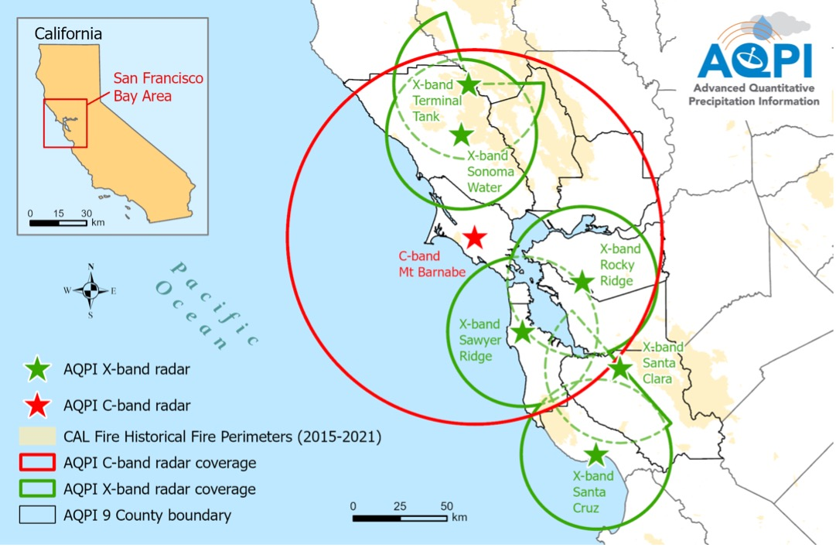
Radar Installation Status
AQPI radar coverage (at right) and installation status (below):
Sonoma Water
Santa Clara
Rocky Ridge
Sawyer Ridge
Santa Cruz
Terminal Tank
Mt Barnabe
Complete / Operational
In Process / Other Issues
Not started

Slide 5
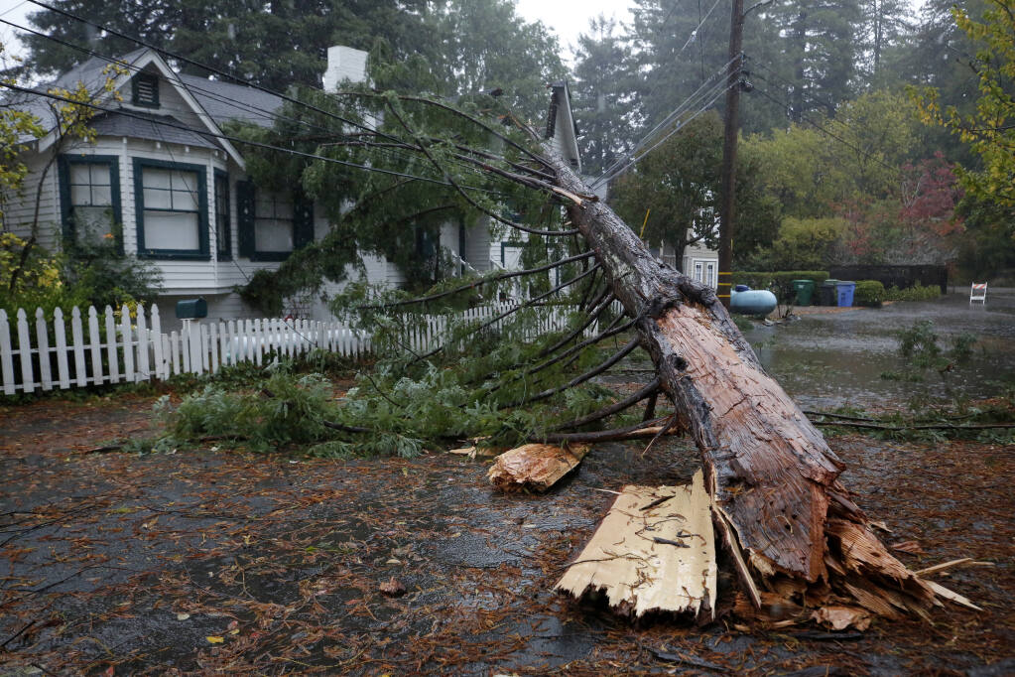
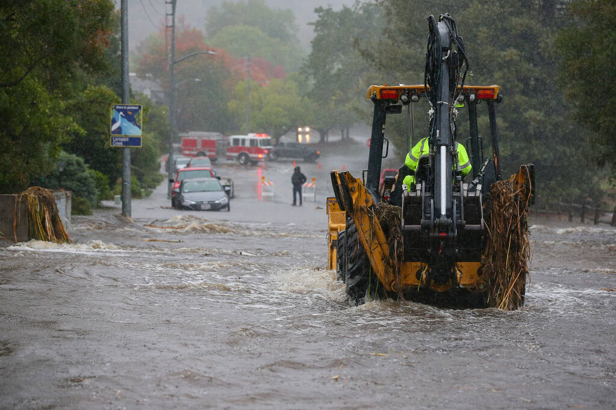
Santa Rosa, CA - 24 Oct 2021 ~1845 UTC
NEXRAD (s-band) from Monterey
AQPI (x-band) from Santa Rosa
Burn Areas
Burn Areas
Guerneville, CA
Santa Rosa
Santa Rosa
Santa Rosa, CA
Source: https://www.pressdemocrat.com/article/news/atmospheric-river-lashes-the-north-bay-bringing-flooding-power-outages/
NCFR!

Slide 6
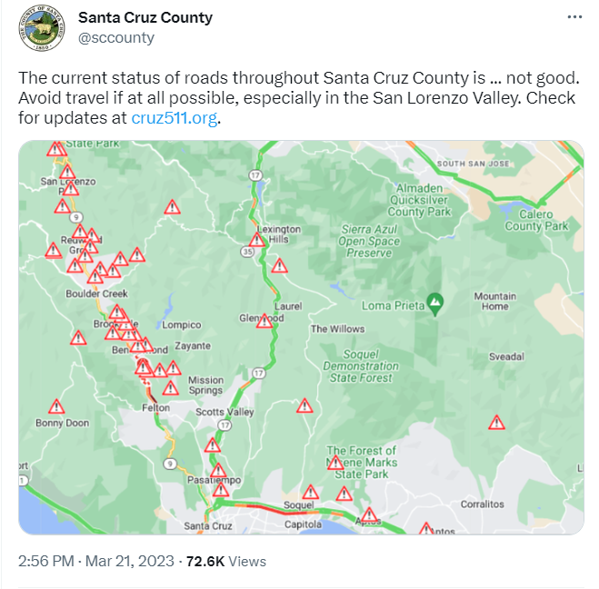
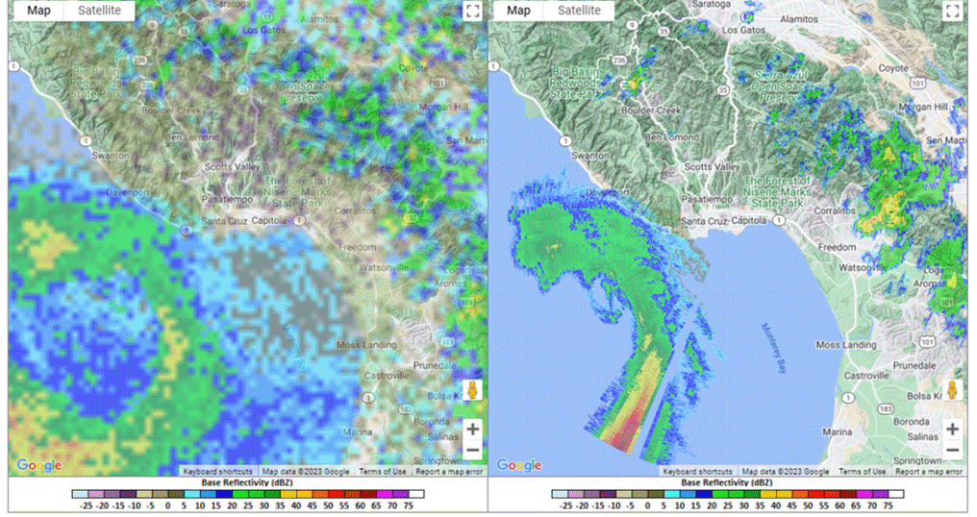
Santa Cruz / San Lorenzo Valley - 21 Mar 2023
AQPI radar pinpointed heaviest precipitation (winds were also a significant factor in this event) – flooding and downed trees.
San Lorenzo Valley
San Lorenzo Valley
San Lorenzo Valley
Santa Cruz
Santa Cruz
Santa Cruz

Slide 7
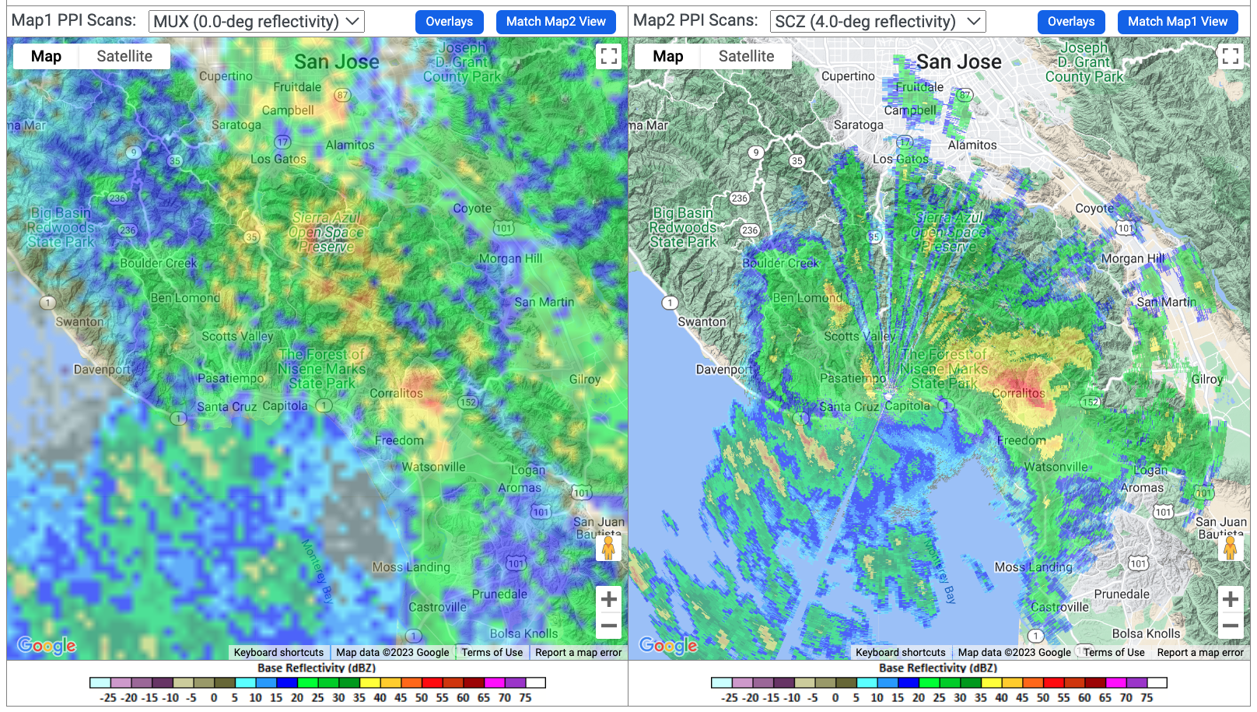
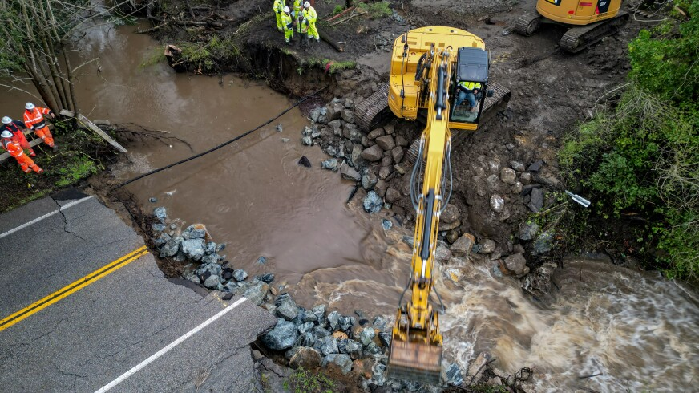
Santa Cruz / Corralitos - 10 Mar 2023
NEXRAD Monterey (MUX) radar (left panel) and AQPI Santa Cruz (SCZ) radar (right panel) at ~2:30am 28 Feb 2023. The SCZ radar shows the heavy convection near Corralitos more clearly.
Approximately ~450 homes were inaccessible when bates Creek washed out the road shown above. Officials from Santa Cruz County used AQPI radar data for guidance on issuing and ending evacuation orders.

Slide 8
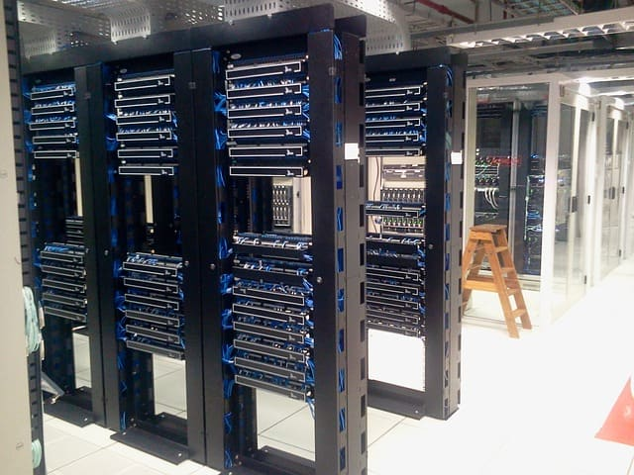
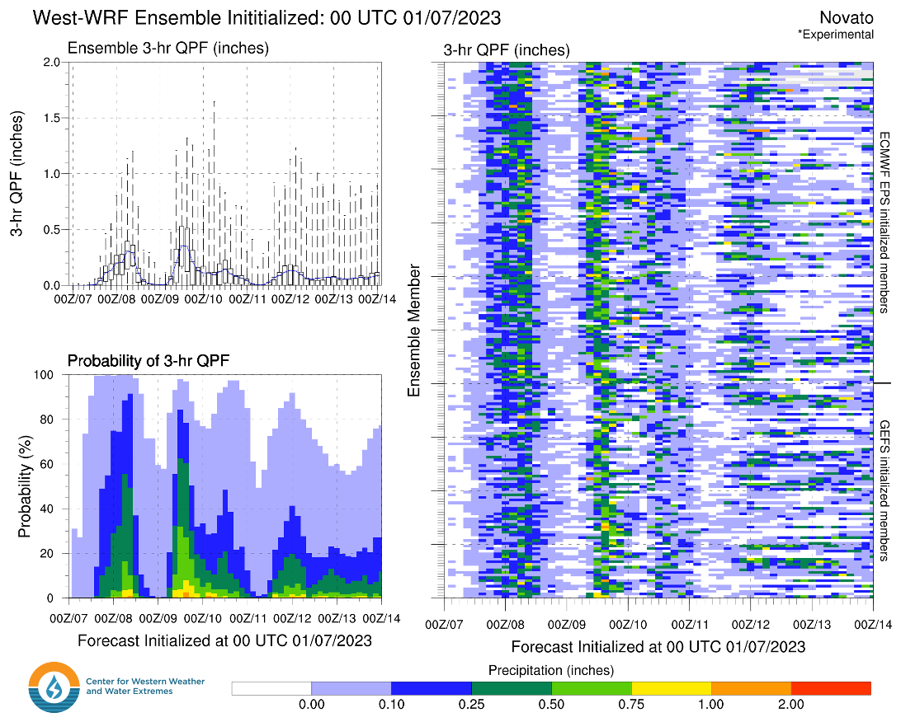
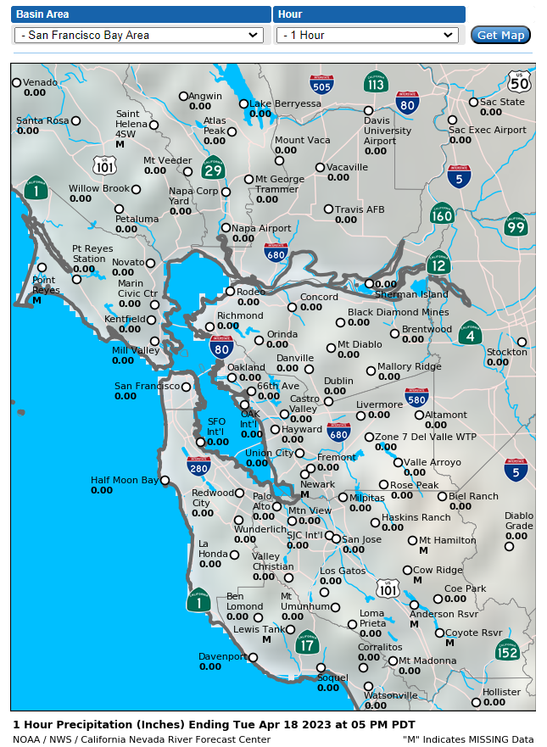
What’s Next? (Program Management)
Programmatic changes over the next ~12 months
Currently, Sonoma County Water Agency administers AQPI, having received the original DWR grant for radar / gauge installation
Beginning 2024, CW3E will begin administering AQPI as focus shifts from installation to long-term demonstration and expansion of the AQPI system
Hardware and software from CSU will be migrated to CW3E, so CSU will remain project lead on radar installation, maintenance, and radar-derived products
CW3E will be hiring program & technical support

Slide 9
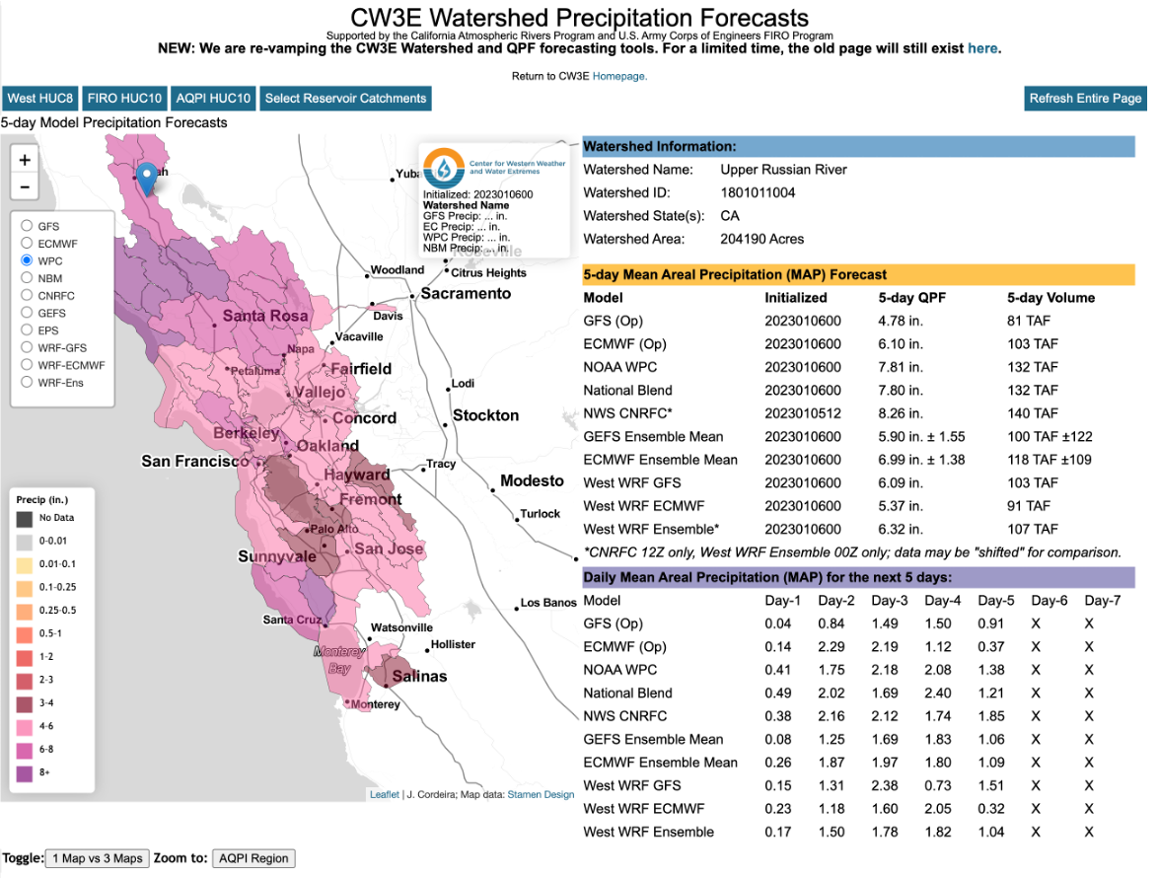
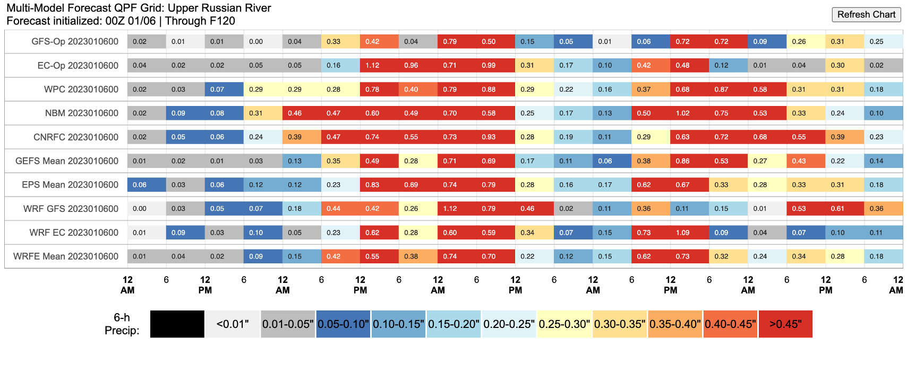
Weather Forecasts that Support AQPI – Watershed Forecast Tool

Slide 10
Weather Forecasts that Support AQPI – West-WRF
Good agreement on highest rainfall rates during a ~9-hour period
Uncertainty on rainfall rates during a ~6-hour period

Slide 11
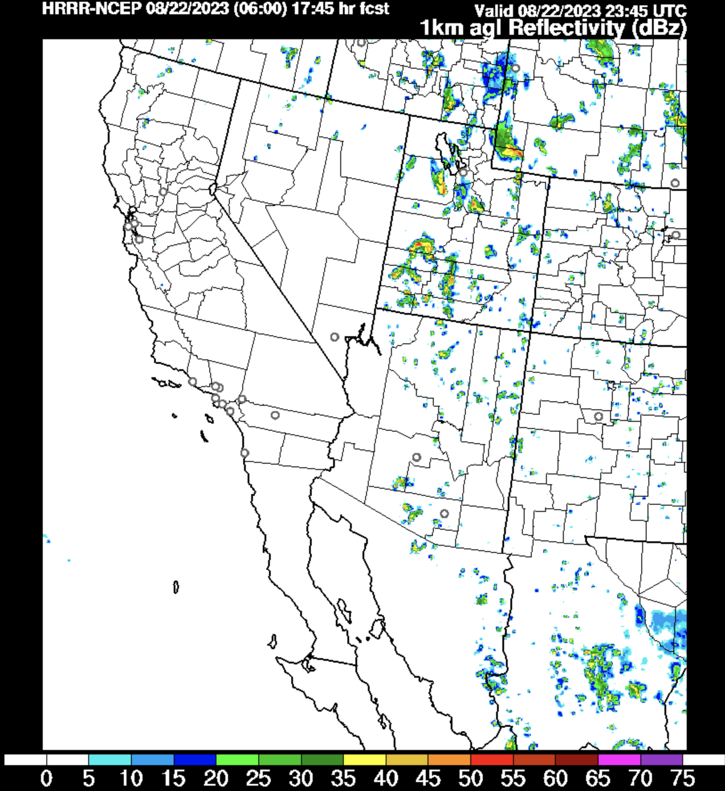
Radar Data Usage in Forecast Models
One major goal of AQPI is assimilation of the new x-band and c-band radar data into weather forecast models… This allows the model to use radar information to improve the short-term (0-3 hour) forecast
CW3E West-WRF: currently have a small team working towards assimilation of radar data into in-house forecast model
HRRR: have reached out to a development team about including AQPI radar data into a process that ultimately assimilates into the HRRR – the NWS’ premier short-term forecast model

Slide 12
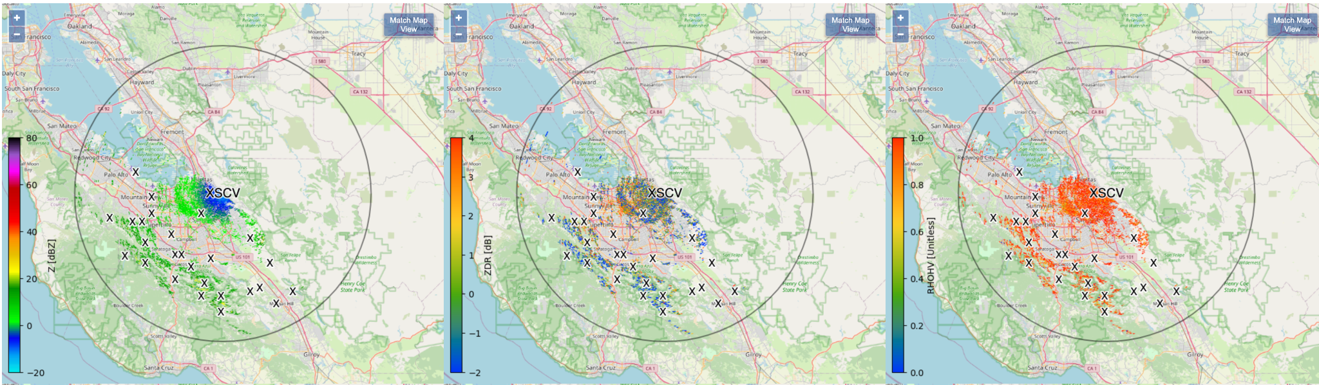
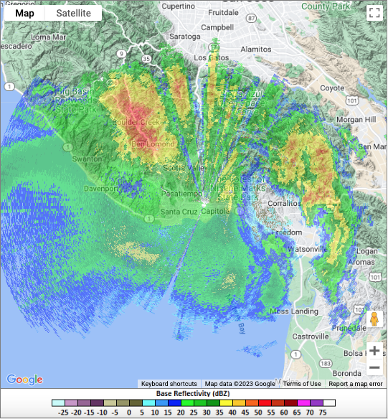
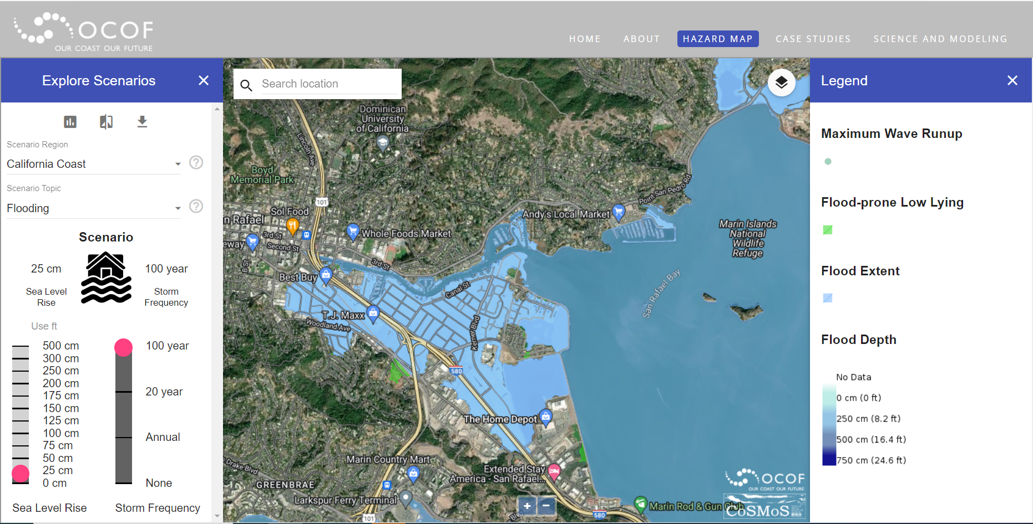
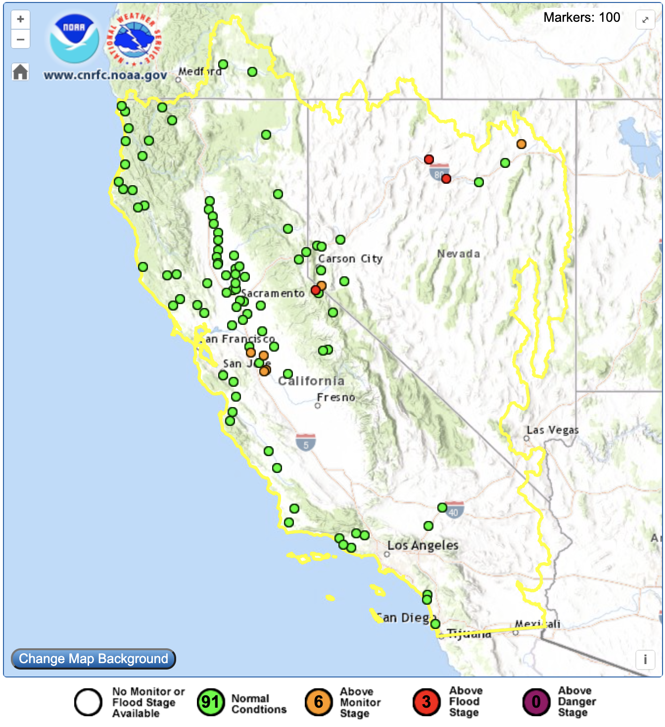
What’s Next? Scientific Effort over the Next ~3 Years
Produce high-quality, multi-radar QPE mosaic inc. bright-band QC and provide this data in formats useful for stakeholder H&H models
Assimilate AQPI radar data into CW3E West-WRF
Engage with national initiatives such as MRMS so that AQPI data flows downstream into HRRR, NWM, etc.
Develop a consolidated user interface with all AQPI-related observational (radar, rain gauge, stream flow) and forecast data – ensure dynamic functionality, data archival, and user friendliness
Provide robust training and stakeholder support

Slide 13
Santa Cruz Case Study
CW3E recently partnered with Bay Planning Coalition and officials from Santa Cruz County to highlight benefits of AQPI to the decision-making process during storms on 10 Mar 2023 (slide 7 from this presentation):
Accessible online: here
The bottom line: AQPI radar data was used and the higher level of detail provided confidence in issuing both evacuation and return-to-home orders for ~450 residences whose accessibility was heavily impacted by flooding / road washouts

Slide 14
Stakeholder Feedback
Mike Anderson, CA State Climatologist, DWR: “DWR’s State Operations Center used AQPI resources to improve situational awareness of storm activity in the Bay Area in its efforts to incorporate information and forecasts to guide deployment of emergency response resources.”
Emily Zedler, Engineer, Valley Water: “Although the DAX was operational during this series of storms, the more nearby MUX on Mount Umunhum was down for part of that timeframe– and having the more detailed/nearby radar images available was useful in confirming what was seen on the DAX. The instantaneous rain rates feature is also quite useful for gaging rain rates, and the National Weather Service actually touted this feature during one of the County Operational Area meetings.” Mark Strudley, Executive Director, Pajaro Regional Flood Management Agency: “The enhanced resolution compared with the NWS S-Band radar allowed for better visibility of incoming storm systems. During the convective phases of some storms, the X-band radar was able to discern active precipitation lower in the atmosphere than the NWS S-band was able to detect. This enhanced the emergency management community’s ability retract evacuation orders and warnings with more confidence as the remnants of the storm were more evident.”
DWR Video on AQPI: Available via LinkedIn (click here)

Slide 15
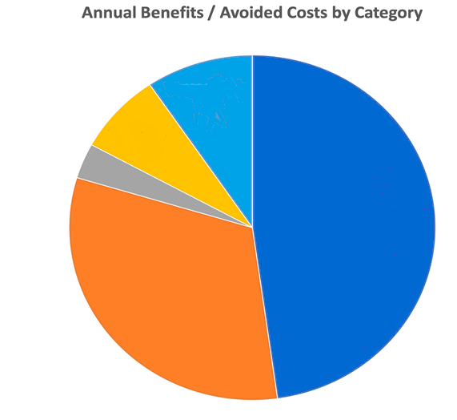
What are the Benefits of AQPI?
NOAA estimates $60.9M/yr avoided costs
Provides severe weather detection, tracking, and forecasting; improves early warning and emergency response support
Improved situational awareness reduces risks to public safety & protects water quality and resources
Supports NOAA’s Weather Ready Nation Initiative
Have begun exploration of a follow-up study, now that system is mostly operational, that will quantify the economic benefit of AQPI
$5.8M/YR
$4.6M/YR
Transportation
9%
Recreation
8%
$2M/YR
Ecosystems
3%
Flood Damage Mitigation
48%
Water Supply
32%
$29M/YR
$19.5M/YR
Johnson, L.E., R Cifelli, A White (2020): Benefits of an advanced quantitative precipitation information system. J Flood Risk Management. https://doi.org/10.1111/jfr3.12573

Slide 16
Summary
Who Needs AQPI?
Jon Rutz (jrutz@ucsd.edu)
AQPI Program Management & Technical Lead
AQPI usage is growing, and stakeholder feedback is informs development. In the future, AQPI data will flow directly & indirectly into stakeholder operations
Real-time radar monitoring will play a role in certain situations
H&H models will be driven by high-quality QPE, ensemble-based (probabilistic) atmospheric forecasts, and a nowcast benefitting from radar data assimilation
These and other radar-derived products will support a robust suite of decision support tools, including supplementary weather forecast products
AQPI data will flow downstream into national initiatives such as MRMS, HRRR, and the National Water Model
Contact
Who Needs AQPI?
Sonoma Water AQPI Info: Access Here
AQPI User Interface: Access Here
NOAA Radar Archive: Access Here
NEXRAD and AQPI Radar Side-by-Sides
Information / Data Access

Slide 17
Stakeholder Feedback
Mike Anderson, DWR, CA State Climatologist: “DWR’s State Operations Center used AQPI resources to improve situational awareness of storm activity in the Bay Area in its efforts to incorporate information and forecasts to guide deployment of emergency response resources.”
Emily Zedler, Valley Water: “The STC X-band radar, which covers much of Santa Clara County, was used extensively for monitoring storms during the series of several Atmospheric Rivers that hit the area in the first half of January. The high resolution, real-time radar images were useful for filling in gaps between rain gages, identifying small cells of intense rainfall (particularly during the storm which included a series of thunderstorms on the night of Jan 10/11), and for gauging how quickly storms were moving through the county. Although the DAX was operational during this series of storms, the more nearby MUX on Mount Umunhum was down for part of that timeframe– and having the more detailed/nearby radar images available was useful in confirming what was seen on the DAX. The instantaneous rain rates feature is also quite useful for gaging rain rates, and the National Weather Service actually touted this feature during one of the County Operational Area meetings.” Mark Strudley, Santa Cruz County: “The Santa Cruz County X-band radar system proved to be a critical addition to the Central Coast’s flood monitoring and warning system during the storms of January 2023. The enhanced resolution compared with the NWS S-Band radar on Mt. Umunhum allowed for enhanced visibility of incoming and incident storms systems. Additionally, when the NWS radar went temporarily out of service several times during the series of storm systems, the X-band radar was the only radar data available, which was also being shared with the NWS office. As a result, the X-band radar enhanced our own operations but also enabled the NWS to provide their standard set of services, which partly rely on radar data. Last but not least, during the convective phases of some storms, the X-band radar was able to discern active precipitation lower in the atmosphere than the NWS S-band was able to detect. This enhanced the emergency management community’s ability retract evacuation orders and warnings with more confidence as the remnants of the storm were more evident.”

Slide 18
Stakeholder Feedback
DWR Video on AQPI: Available via LinkedIn (click here)
Valley Water also provided their assessment of key AQPI benefits:
1) Improved spatial resolution: fills in data gaps between gages; allows us to see small, intense cells that move between them. Helped somewhat with figuring out when it was safe to decommission crews (detail improved our confidence). This could also help us deploy staff to a certain location potentially.
2) Improved temporal resolution: can act as an early warning that intense rainfall has started. E.g., our gages typically report out every 15 minutes. While true that there are ways to get some of that data more quickly/frequently than the typical report out period (e.g., by texting the gages directly) and/or looking at images from our hot spot cameras, having access to the detailed radar data can provide early warning of intense rainfall (it is easier to look at). Some of our urban creeks have very quick response times, with flow rising very quickly during intense rainfall. In general, you would see the intense rainfall on the radar first, followed by our rain gages picking it up.
3) Redundancy: the January storms had high winds in addition to larger rainfall events. The winds caused a lot of power outages- including a power issue to Mt. Umunhum, which took out the MUX radar during at least half of the January storm season. Having the X band radar was helpful as it served as backup, noting that there were still NEXRAD radar feeds coming from the radar in Davis.
4) Multiple Data Sources: Also, it was nice to have cross-confirmation of our data. Seeing consistency between the radar, rain gages, stream gages, and data collected by on-site folks gives you confidence; having multiple sources is helpful (they usually agree). When they don’t agree, this information can be helpful for identifying issues with e.g., a malfunctioning instrument.

